Slide 1
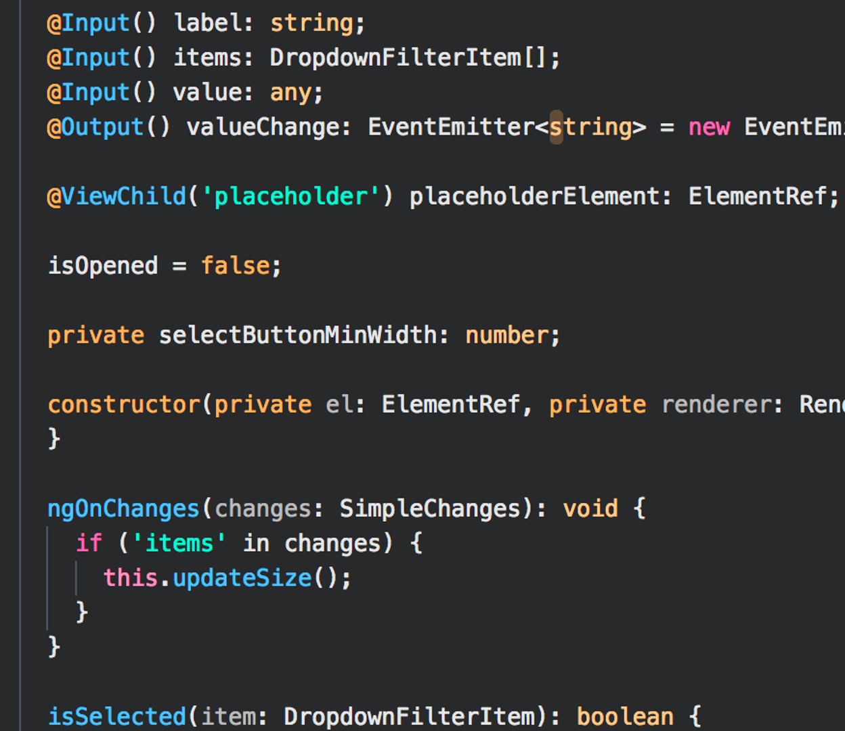


Web App
Fullstack Challenge
2023
CONFIDENTIAL AND PROPRIETARY Any use of this material without specific permission of Swisscom Digital Technology SA is strictly prohibited

Slide 2

Goal of the challenge
UC 1
The user opens your app and gets a login screen. He has to login. After a successful login he is redirected to the overview page (UC2).
Create the Boat Application
It’s a simple app, where a user can get a quick overview over list of boats.
The four described use cases should be implemented.
UC 2
The user has a list of all boat resources.
UC 3
The user can add, update or delete a boat.
UC 4
The user clicks on a boat item and gets a detail view over it.

Slide 3

The following functional requirements are expressed by our client
REQ 1
Create an CRUD endpoint for managing boats. A boat should have at least the following attributes and appropriate validation:
Name
Description
REQ 2
Implement the following security aspects.
Authentication / Authorization (only authenticated user can access resources )

Slide 4
We are free to choose any of those stacks for the implementation, pick your favorite one !
Backend
Java / Spring Boot | https://spring.io/quickstart
.NET Core Web API | https://learn.microsoft.com/en-us/aspnet/core/tutorials/first-web-api
NodeJS | https://nodejs.org/en/docs/guides/getting-started-guide
Frontend
Angular | https://angular.io/start
Vue.js | https://vuejs.org/guide/quick-start.html
React | https://react.dev/learn
Notes
•Use Git and make your code available via GitHub or Bitbucket.
•Use appropriate tools, libraries, and frameworks to make your life easy.

Slide 5

We make it happen
Swisscom Digital Technology SA | Avenue de Rhodanie 40C, 1007 Lausanne | owt.swiss

